Slide 1
IEEE eBook Access in IEEE Xplore Digital Library
MIT Press eBooks Library-
Computing & Engineering Collection
Morgan & Claypool –
Synthesis eBooks Library

Slide 2
IEEE MIT Press eBooks Library- Computing and Engineering Collection
High quality eBooks content in computer science and engineering
Access to more than 700 titles in numerous technology fields via the IEEE Xplore digital library
Covers computer science, artificial intelligence, information theory, computer programming, information technology, electrical engineering and more
Available as an add-on to your existing IEEE Xplore subscription or as a stand-alone subscription.

Slide 3
IEEE MIT Press eBooks Library- Quick Facts
Access to more than 675 titles via IEEE Xplore
Expect to add 40 new titles each year to the collection
More than 70% of titles are in computing related fields
Rigorous review process ensures titles are relevant and high quality
Several award winning titles for professional and scholarly excellence (PROSE Awards)
Approximately 13,000 individual chapters available in PDF
Perpetual access option available
Free trials available

Slide 4
IEEE MIT Press eBooks Library- Content Areas
The collection includes titles with an emphasis on leading areas of applied research, such as:
Bioengineering
Communication, Networking, and Broadcasting
Components, Circuits, Devices, and Systems
Computing and Processing
Engineered Materials, Dielectrics, and Plasmas
Engineering Profession
Fields, Waves, and Electromagnetics
Geoscience
Power, Energy, and Industry Applications
Robotics and Control Systems
Signal Processing
Transportation

Slide 5
IEEE Morgan&Claypool Digital Library - Synthesis Sample Subjects

Slide 6
IEEE Morgan&Claypool Digital Library - Quick Facts
Focusing on computer science and engineering innovations
Access more than 875 peer-reviewed titles in concise lecture format
Backfile to 2006
Approximately 100 titles are added to new collections with new titles added monthly
Advanced content in computer science
eBook titles are delivered as complete eBook title PDFs
Content extends into areas such as ethics, economics, gender, and technology’s impact on society
Synthesis ties the best of quantitative data with the best of qualitative data

Slide 7
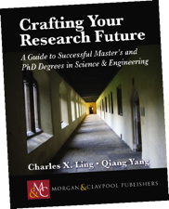
IEEE Morgan&Claypool Digital Library - Content Areas Include:
Algorithms and Software in Engineering
Artificial Intelligence & / Machine Learning
Biomedical Engineering
Computer Architecture
Data Management
Digital Circuits & Systems
Distributed Computer Theory
Engineers, Technology & Society
Global Engineering
Human-Centered Informatics
Information Security, Privacy & Trust
Mathematics & Statistics
Power Electronics
Quantum Computing
Tissue Engineering
Plus general topics for engineers

Slide 8
IEEE Leaders are Morgan & Claypool Editors
Featuring a number of highly-respected and well-known series editors
Al Bovik
Former Editor: IEEE Transactions on Image Processing
Founder: IEEE International Conference on Image Processing
M&C Series Editor: Synthesis Lectures on Image, Video, and Multimedia Processing
Constantine A. Balanis
IEEE Life Fellow
M&C Series Editor: Synthesis Lectures on Antennas
M&C Series Editor: Synthesis Lectures on Computational Electromagnetics
John Enderle
Former President: IEEE Engineering in Medicine & Biology
Former Editor: IEEE EMBS Magazine
M&C Series Editor: Synthesis Lectures on Biomedical Engineering
Jerry Hudgins
Former President: IEEE Power Electronics Society and former President IEEE Industrial Applications Society
M&C Series Editor: Synthesis Lectures on Power Electronics
B.H. Juang
Former Editor: IEEE Transactions on Speech and Audio Processing
M&C Series Editor: Synthesis Lectures on Speech & Audio Processing
Jose Moura
Former President: IEEE Signal Processing Society
Editor: IEEE Transactions on Signal Processing
M&C Series Editor: Synthesis Lectures on Signal Processing

Slide 9
Search IEEE eBooks

Slide 10
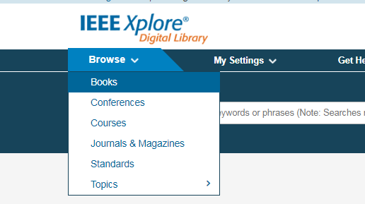
Browse eBooks
Finding a eBook
Go to www.ieee.org/ieeexplore
Under the Browse menu in the upper left hand corner, choose Books

Slide 11
Browse eBooks
2. Search by Topic
1. Search keywords by title

Slide 12
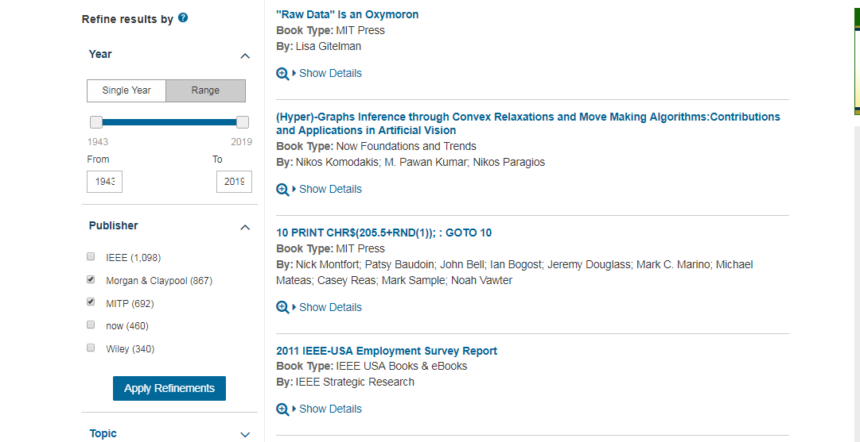
Browse eBooks
Refine your result by selecting Morgan & Claypool and MITP, then clicking Apply Refinements

Slide 13
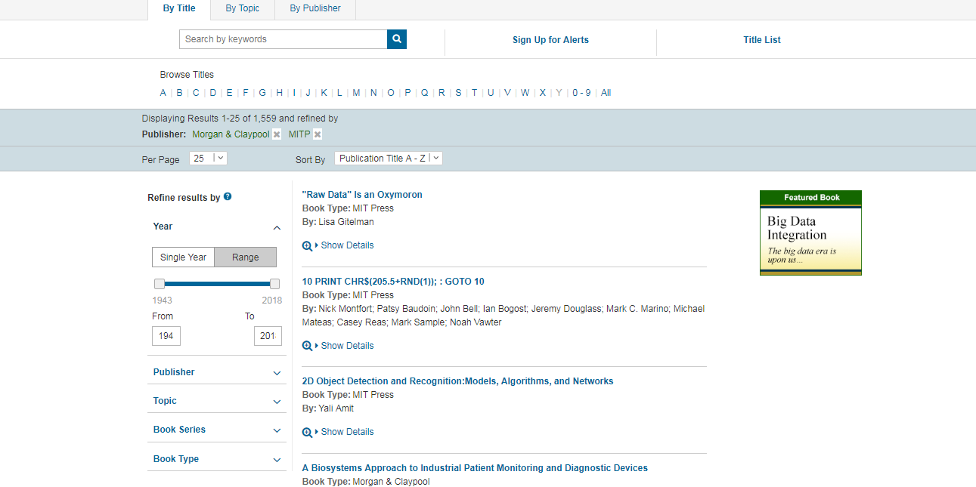
Browse eBooks
Click the book title you like

Slide 14
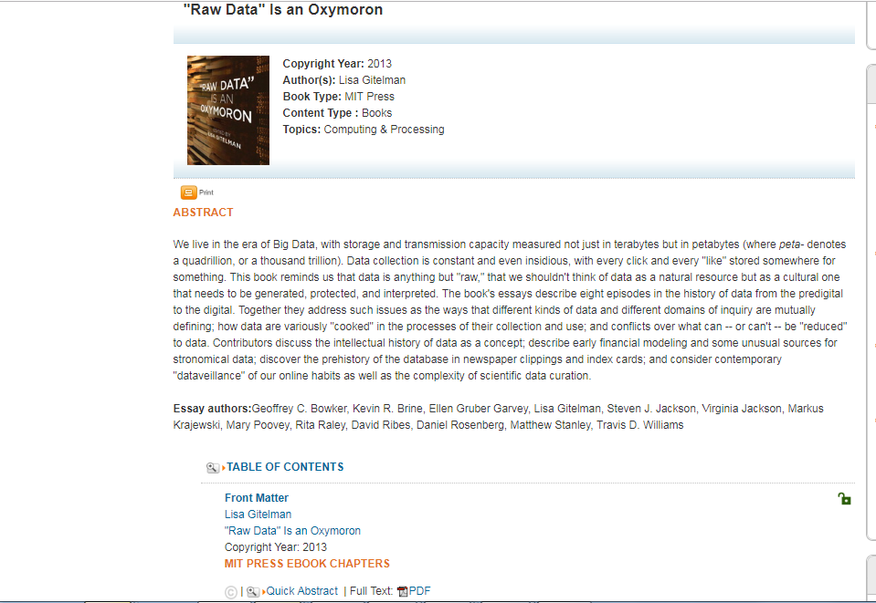
Browse eBooks
MITP - individual chapters available in PDF

Slide 15
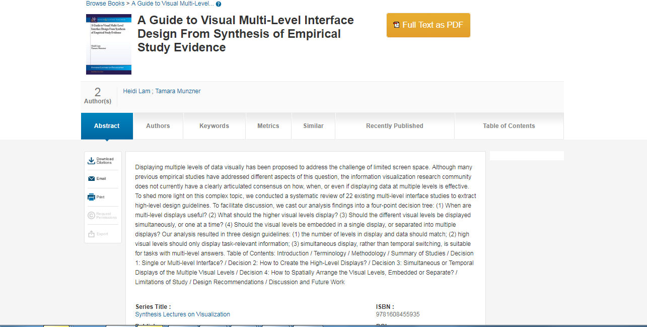
Browse eBooks
Browse eBooks
Morgan & Claypool -delivery as one complete PDF per eBook

Slide 16
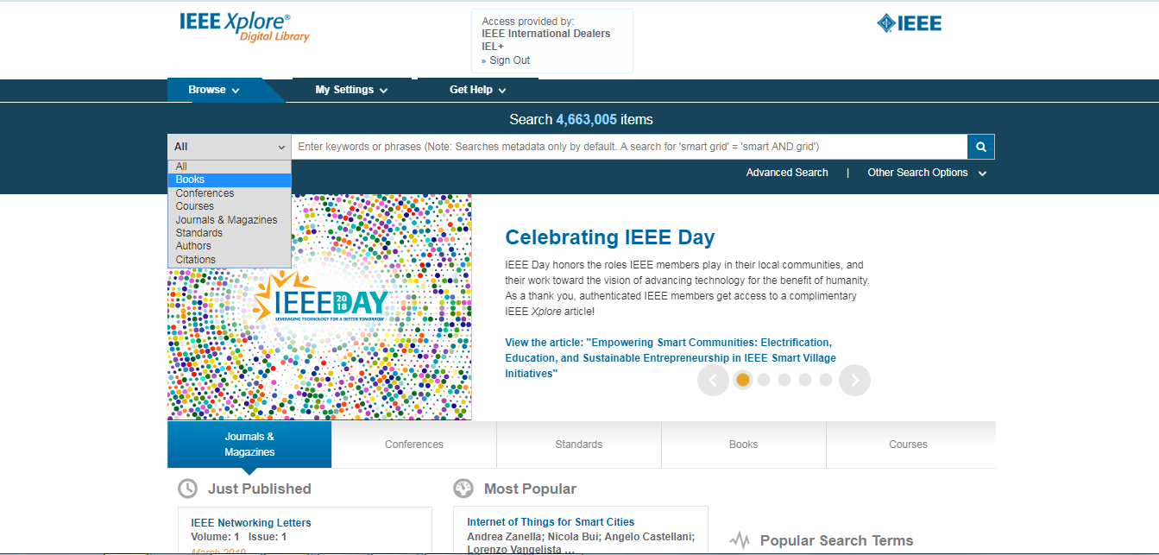
Search eBooks
IEEE Xplore searches for all terms in the metadata and ranks results by relevance. Enter keywords for searching books

Slide 17
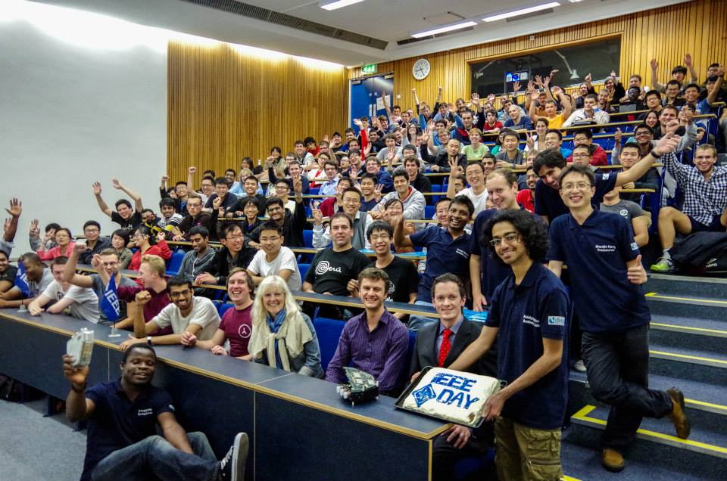
More about IEEE Xplore®
Live Online Training : http://ieeexplore.ieee.org/Xplorehelp/#/ieee-xplore-training/video-tutorials
Apply IEEE Online Training : www.ieee.org/go/training
IEEE Xplore Digital Library : www.ieee.org/ieeexplore
The Best Professional Development Activity Winner – - IEEE University of Southampton Student Branch (STB09551) ,UK&RI Section

